Slide 1
Ethical and technical considerations around using register data

Slide 2
Research Ethics
Consent
Truly voluntary, truly informed?
Foot-in-the-door
Access vs transparency
Deterrence, discipline and safeguard

Slide 3
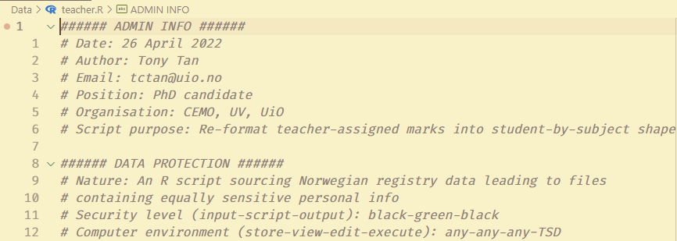
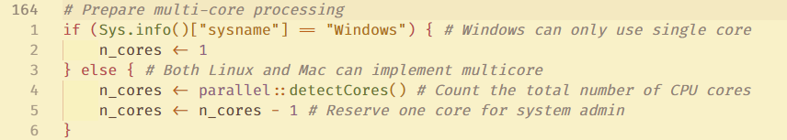
Technical Considerations
TSD export criteria
Data wrangling
Analysis code
Accountability
Security declaration
# Comments
Inter-operability
Non-interactive mode

